Slide 1




Date of Publication
September 22, 2025
WEEKLY
THREAT DIGEST
Attacks, Vulnerabilities, and Actors
15 to 21 SEPTEMBER 2025

Slide 2
Table Of Contents
Summary
03
High Level Statistics
04
Insights
05
Targeted Countries
06
Targeted Industries
07
Top MITRE ATT&CK TTPs
07
Attacks Executed
08
Vulnerabilities Exploited
14
Adversaries in Action
16
Recommendations
18
Threat Advisories
19
Appendix
20
What Next?
26
2

Slide 3
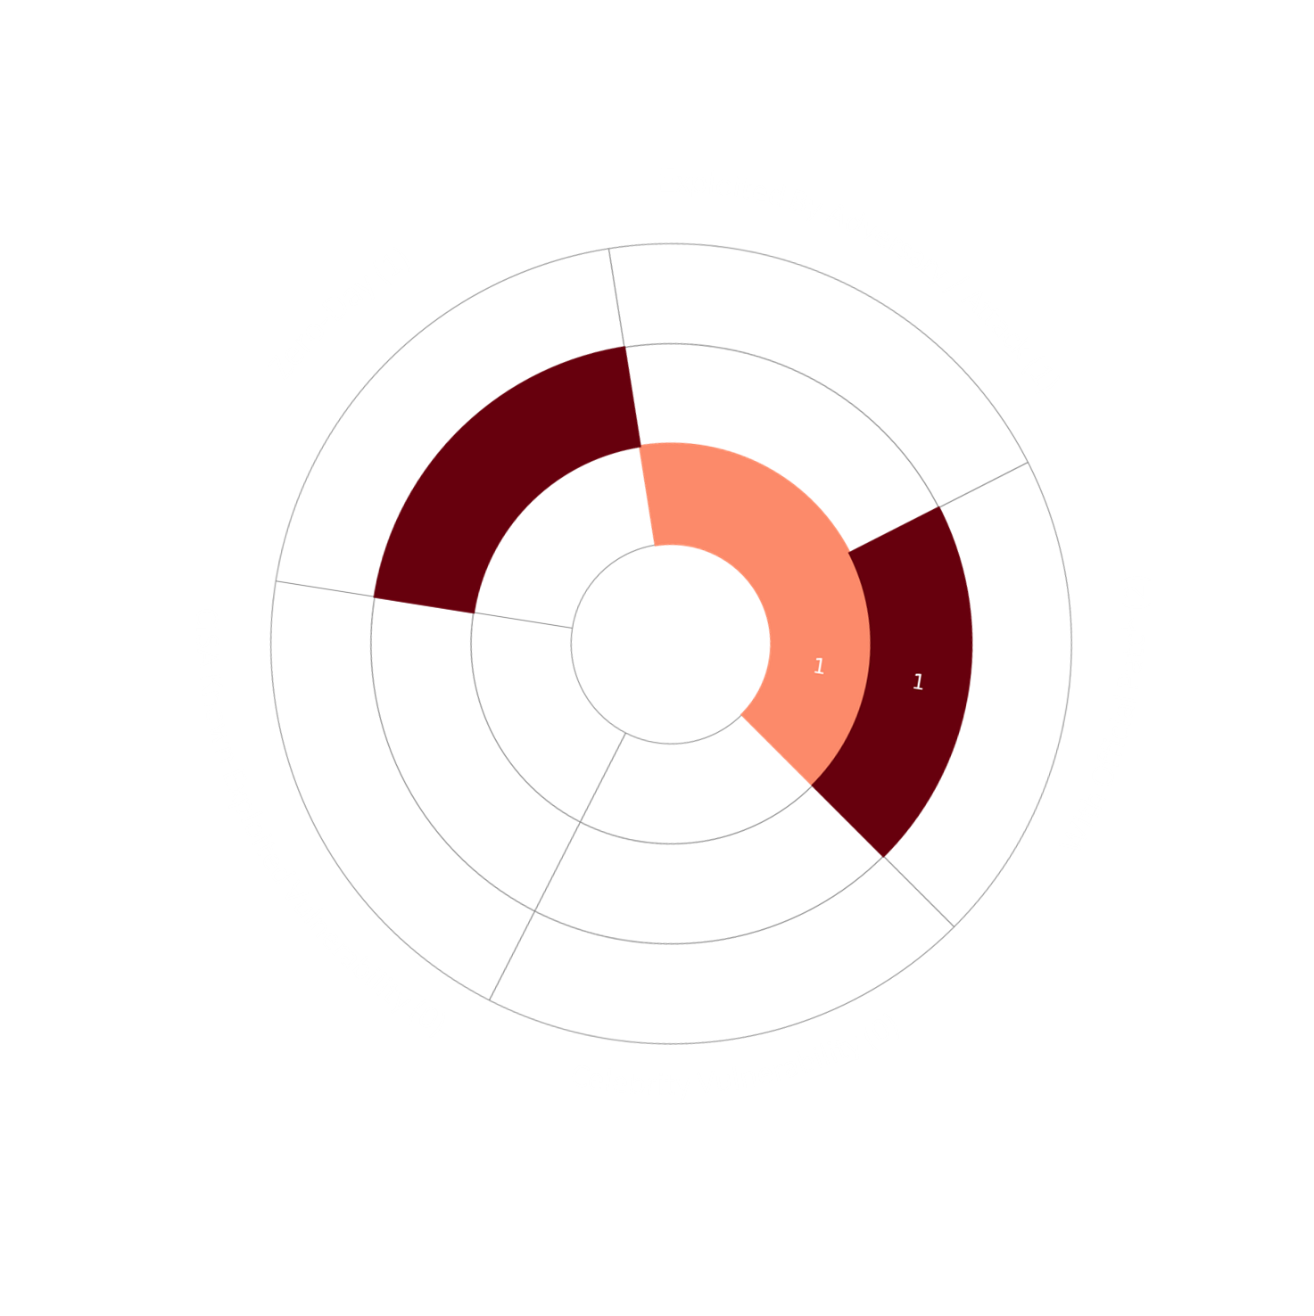
Summary
HiveForce Labs has reported a sharp rise in cyber threats, highlighting the increasing complexity and frequency of attacks. Over the past week alone, twelve major attacks were detected, two vulnerabilities were actively exploited, and two threat actor groups were closely tracked, signaling an alarming escalation in malicious activity across digital environments.
In a concerning development, Google released critical security updates for Chrome to address its sixth zero-day vulnerability of 2025, CVE-2025-10585, a type confusion flaw in the V8 JavaScript engine that is already being exploited in the wild. Additionally, CVE-2024-7344, a vulnerability in the Howyar Reloader UEFI application, is being leveraged by the HybridPetya ransomware to bypass Secure Boot- a security feature designed to prevent unauthorized code from running during startup.
Meanwhile, several sophisticated malware campaigns are wreaking havoc globally. EvilAI masquerades as legitimate AI tools, using polished interfaces and stolen code-signing certificates to lure users into installing it. BlackNevas ransomware, first spotted in November 2024, continues to spread across Asia, Europe, and North America, hitting industries like healthcare, finance, manufacturing, and legal services. Supply chain attacks are also on the rise, as seen in the Shai-Hulud campaign targeting npm package maintainers. Even the hospitality sector is under threat: RevengeHotels (TA558) uses fake invoices and job applications to infiltrate hotel front desks, deploying VenomRAT to steal payment data and disable security tools. Together, these events emphasize the critical need for proactive defenses, timely patching, and resilient cybersecurity strategies in today’s increasingly hostile digital landscape.
1175
395.6K
02
Total Vulnerabilities Published
Vulnerabilities Published in the Week
Exploited Vulnerabilities
3

Slide 4



High Level Statistics
12
Attacks Executed
2
Vulnerabilities Exploited
2
Adversaries in Action
EvilAI
HybridPetya
SnakeDisk
Yokai
Pubload
Toneshell
StealC
Yurei
BlackNevas
VenomRAT
Shai-Hulud
SilentSync
CVE-2024-7344
CVE-2025-10585
Hive0154
RevengeHotels
THREAT DIGEST• WEEKLY
4
|

Slide 5



Insights
Behind a friendly AI facade, EvilAI hides its true malicious intent.
CVE-2025-10585: Google’s sixth zero-day this year highlights the urgent need for Chrome updates.
HybridPetya fuses Petya and NotPetya traits with next-gen capabilities, even bypassing UEFI Secure Boot.
Shai-Hulud’s supply chain strike shows the dangers lurking in popular npm packages.
One click, massive theft - FileFix uses fake dialogs to deliver StealC and harvest sensitive data.
Behind the front desk: TA558 exploits staff trust to deploy VenomRAT silently.
THREAT DIGEST• WEEKLY
5
|

Slide 6

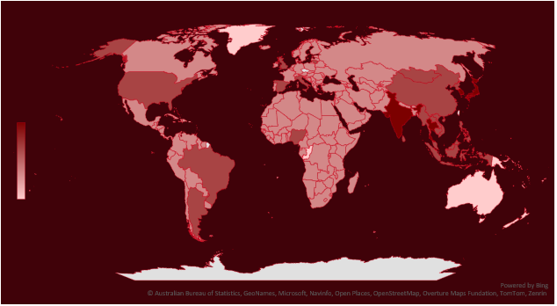
Targeted Countries
Most
Least
 | Countries
 | Singapore
 | Thailand
 | South Korea
 | India
 | Japan
 | China
 | Philippines
 | Nigeria
 | Argentina
 | Cambodia
 | Indonesia
 | Myanmar
 | Italy
 | North Korea
 | Sri Lanka
 | Brunei
 | Brazil
 | Spain
 | United Kingdom
 | Vietnam
 | Timor-Leste
 | Laos
 | United States
 | Malaysia
 | Mongolia
 | Countries
 | Lithuania
 | Sudan
 | North Macedonia
 | Mauritius
 | Burundi
 | Sao Tome & Principe
 | Cabo Verde
 | United Arab Emirates
 | Angola
 | Bangladesh
 | Cameroon
 | Poland
 | Canada
 | Slovenia
 | Central African Republic
 | Botswana
 | Chad
 | Zambia
 | Chile
 | Bahrain
 | Antigua and Barbuda
 | Nicaragua
 | Colombia
 | Countries
 | Panama
 | Comoros
 | Russia
 | Congo
 | Seychelles
 | Costa Rica
 | South Sudan
 | Côte d'Ivoire
 | Syria
 | Croatia
 | Turkey
 | Cuba
 | Uzbekistan
 | Cyprus
 | Malta
 | Czech Republic (Czechia)
 | Burkina Faso
 | Denmark
 | Morocco
 | Djibouti
 | Nepal
 | Dominica
 | Barbados
 | Dominican Republic
 | Oman
 | Countries
 | Qatar
 | Egypt
 | Saint Lucia
 | El Salvador
 | Senegal
 | Equatorial Guinea
 | Belize
 | Eritrea
 | South Africa
 | Estonia
 | Bolivia
 | Eswatini
 | Sweden
 | Ethiopia
 | Tanzania
 | Finland
 | Trinidad and Tobago
 | France
 | Uganda
 | Gabon
 | Andorra
 | Gambia
 | Bulgaria
 | Georgia
 | Mali
THREAT DIGEST• WEEKLY
6
|

Slide 7

Targeted Industries
TOP MITRE ATT&CK TTPs
T1059
Command and Scripting Interpreter
T1027
Obfuscated Files or Information
T1071
Application Layer Protocol
T1547
Boot or Logon Autostart Execution
T1547.001
Registry Run Keys / Startup Folder
T1068
Exploitation for Privilege Escalation
T1566
Phishing
T1555
Credentials from Password Stores
T1036
Masquerading
T1059.001
PowerShell
T1204
User Execution
T1053
Scheduled Task/Job
T1203
Exploitation for Client Execution
T1189
Drive-by Compromise
T1059.007
JavaScript
T1041
Exfiltration Over C2 Channel
T1070
Indicator Removal
T1588
Obtain Capabilities
T1140
Deobfuscate/Decode Files or Information
T1486
Data Encrypted for Impact
THREAT DIGEST• WEEKLY
7
|

Slide 8

Attacks Executed
NAME | OVERVIEW | DELIVERY METHOD | TARGETED CVE
EvilAI | EvilAI is a deceptive malware family that impersonates legitimate AI software, using polished user interfaces, functional features, and even stolen code-signing certificates, to trick victims into installing it. After deployment it blends into the environment by mimicking common processes, registering misleading scheduled tasks, and applying multi-layered obfuscation to evade detection. Covertly it establishes encrypted channels to attacker-controlled command-and-control servers, exfiltrates browser-stored credentials and other sensitive artifacts, and prepares the host for follow-on modules, creating a stealthy staging ground that can turn a single compromised workstation into a broader data-theft incident. | Social Engineering | -
 |  | IMPACT | AFFECTED PLATFORM
 |  | Data Theft | Windows
TYPE |  |  | -
Stager |  |  | -
ASSOCIATED ACTOR |  |  | PATCH LINK
- |  |  | -
IOC TYPE | VALUE
SHA256 | 8ecd3c8c126be7128bf654456d171284f03e4f212c27e1b33f875b8907a7bc65
NAME | OVERVIEW | DELIVERY METHOD | TARGETED CVE
HybridPetya | HybridPetya is an emerging ransomware variant that fuses elements of both Petya and NotPetya while introducing modern enhancements tailored for today’s environments. Once executed, it tampers with boot components, initiates a fake “CHKDSK” routine to mask its activity, and ultimately presents victims with a ransom note demanding Bitcoin in exchange for decryption. What makes HybridPetya particularly concerning is its ability to bypass Secure Boot and target systems with UEFI support, extending its reach to more modern infrastructures. | - | CVE-2024-7344
 |  | IMPACT | AFFECTED PRODUCT
 |  | Encrypt Data, Data Theft | Howyar Reloader UEFI Application
TYPE |  |  | -
Ransomware |  |  | -
ASSOCIATED ACTOR |  |  | PATCH LINK
 |  |  | https://uefi.org/revocationlistfile , https://msrc.microsoft.com/update-guide/vulnerability/CVE-2024-7344
- |  |  | https://support.sap.com/en/my-support/knowledge-base/security-notes-news/may-2025.html
IOC TYPE | VALUE
SHA1 | BD35908D5A5E9F7E41A61B7AB598AB9A88DB723D
The IOCs (Indicators of Compromise) for the attacks executed are listed in the appendix section at the end of the report.
THREAT DIGEST• WEEKLY
8
|

Slide 9
NAME | OVERVIEW | DELIVERY METHOD | TARGETED CVE
SnakeDisk | SnakeDisk is a USB-propagating worm attributed to Hive0154 that runs via DLL sideloading. It uses a deceptive export stub and accepts two modes: -Embedding (infects USB drives and drops the embedded payload when a device is removed) and -hope (immediately drops and executes the embedded payload), enabling both delayed USB-based spread and instant execution. | Social Engineering | -
 |  | IMPACT | AFFECTED PRODUCT
 |  | Data Theft | -
TYPE |  |  | -
USB worm |  |  | -
ASSOCIATED ACTOR |  |  | PATCH LINK
Hive0154 |  |  | -
IOC TYPE | VALUE
SHA26 | dd694aaf44731da313e4594d6ca34a6b8e0fcce505e39f8273b9242fdf6220e0
NAME | OVERVIEW | DELIVERY METHOD | TARGETED CVE
Yokai | Yokai is a lightweight backdoor that establishes a reverse shell over anonymous pipes, giving operators remote command execution on the infected host. It shares architectural and tradecraft similarities with Hive0154-linked families like Pubload/Pubshell and Toneshell, similar pipe-based shell mechanics and C2 patterns, though it remains a distinct implant. | Social Engineering | -
 |  | IMPACT | AFFECTED PRODUCT
 |  | System Compromise | -
TYPE |  |  | -
Backdoor |  |  | -
ASSOCIATED ACTOR |  |  | PATCH LINK
Hive0154 |  |  | -
IOC TYPE | VALUE
SHA256 | 35bec1d8699d29c27b66e5646e58d25ce85ea1e41481d048bcea89ea94f8fb4b
URL | hxxp[:]//118[.]174[.]183[.]89/kptinfo/import/index[.]php
The IOCs (Indicators of Compromise) for the attacks executed are listed in the appendix section at the end of the report.
THREAT DIGEST• WEEKLY
9
|

Slide 10
NAME | OVERVIEW | DELIVERY METHOD | TARGETED CVE
Pubload | Pubload is a modular downloader that supports decoy C2 servers and can retrieve shellcode both via HTTP POST and over raw TCP streams that mimic TLS traffic, making its network activity harder to distinguish from legitimate encrypted connections. | Social Engineering | -
 |  | IMPACT | AFFECTED PRODUCT
 |  | Information Theft, Espionage, Exfiltration | -
TYPE |  |  | -
Downloader |  |  | -
ASSOCIATED ACTOR |  |  | PATCH LINK
Hive0154 |  |  | -
IOC TYPE | VALUE
IPv4 | 188[.]208[.]141[.]196
NAME | OVERVIEW | DELIVERY METHOD | TARGETED CVE
Toneshell | Toneshell is a sophisticated backdoor that leverages DLL side-loading to execute stealthily and uses a tightly scripted command set to locate and extract files from compromised networks. The latest variant, Toneshell9, adds enterprise-evasion features: C2 traffic can be routed through locally configured proxies to blend with normal network flows, and the implant can maintain two concurrent reverse shells for parallel operator access and redundancy. These capabilities make it effective at covert data extraction and persistent remote control within large, proxy-enabled environments. | Social Engineering | -
 |  | IMPACT | AFFECTED PRODUCT
 |  | Data Theft, System Compromise | -
TYPE |  |  | -
Backdoor |  |  | -
ASSOCIATED ACTOR |  |  | PATCH LINK
Hive0154 |  |  | -
IOC TYPE | VALUE
SHA256 | f8b28cae687bd55a148d363d58f13a797486f12221f0e0d080ffb53611d54231, 8132beeb25ce7baed0b561922d264b2a9852957df7b6a3daacfbb3a969485c79
IPv4 | 146[.]70[.]29[.]229
The IOCs (Indicators of Compromise) for the attacks executed are listed in the appendix section at the end of the report.
THREAT DIGEST• WEEKLY
10
|

Slide 11
NAME | OVERVIEW | DELIVERY METHOD | TARGETED CVE
StealC | StealC is a versatile information-stealing implant that primarily harvests sensitive data from infected hosts. Once present, it enumerates the user environment to extract stored credentials, browser artifacts (cookies, history, autofill), data from popular gaming and chat clients, and cryptocurrency wallet files or keys, packaging this loot and exfiltrating it to attacker-controlled servers. | Phishing | -
 |  | IMPACT | AFFECTED PRODUCT
 |  | Data Theft | -
TYPE |  |  | -
Infostealer |  |  | -
ASSOCIATED ACTOR |  |  | PATCH LINK
- |  |  | -
IOC TYPE | VALUE
SHA256 | 70ae293eb1c023d40a8a48d6109a1bf792e1877a72433bcc89613461cffc7b61
NAME | OVERVIEW | DELIVERY METHOD | TARGETED CVE
Yurei | Yurei is a Go-based ransomware first observed on September 5, 2025, that appears to be a light fork of the open-source Prince ransomware, sharing most of the same code with only minor edits, and has been seen in campaigns that overlap with activity attributed to CrazyHunter. It encrypts victim files using the ChaCha20 cipher and appends the .Yurei extension, leaving systems and data inaccessible until a ransom is paid. | - | -
 |  | IMPACT | AFFECTED PRODUCT
 |  | Data Theft, Encrypt Data | -
TYPE |  |  | -
Ransomware |  |  | -
ASSOCIATED ACTOR |  |  | PATCH LINK
- |  |  | -
IOC TYPE | VALUE
SHA256 | 49c720758b8a87e42829ffb38a0d7fe2a8c36dc3007abfabbea76155185d2902
TOR Address | fewcriet5rhoy66k6c4cyvb2pqrblxtx4mekj3s5l4jjt4t4kn4vheyd[.]onion
The IOCs (Indicators of Compromise) for the attacks executed are listed in the appendix section at the end of the report.
THREAT DIGEST• WEEKLY
11
|

Slide 12
NAME | OVERVIEW | DELIVERY METHOD | TARGETED CVE
BlackNevas | BlackNevas (aka Trial Recovery) is a sophisticated double-extortion ransomware variant, first identified in November 2024 and descended from the Trigona family. It combines strong file encryption with aggressive data theft, renaming encrypted files with a distinctive .-encrypted extension and dropping how_to_decrypt.txt ransom notes in every folder. Victims are pressured to negotiate via email or Telegram and threatened with public leaks, auctions, or publication of exfiltrated data if they do not pay within seven days. | Phishing, Exploiting Vulnerabilities | -
 |  | IMPACT | AFFECTED PRODUCT
 |  | Data Theft, Encrypt Data | -
TYPE |  |  | -
Ransomware |  |  | -
ASSOCIATED ACTOR |  |  | PATCH LINK
- |  |  | -
IOC TYPE | VALUE
SHA256 | 23642a78addcffd124db133a2dd2fcd2d1bdb060dd1e41da33cb18eec7a88867
TOR | Hxxp[://]ctyfftrjgtwdjzlgqh4avbd35sqrs6tde4oyam2ufbjch6oqpqtkdtid[.]onion
NAME | OVERVIEW | DELIVERY METHOD | TARGETED CVE
VenomRAT | VenomRAT is a commercialized remote-access trojan that evolved from the open-source QuasarRAT and has been sold on underground markets since its discovery in mid-2020 (lifetime licenses have advertised prices up to ~$650). Despite portions of its source leaking, actors continue to build and sell custom clients: each implant is generated with tailored configuration data that the malware protects using AES encryption under PKCS #5 v2.0, plus an HMAC-SHA256 authenticity check. The implant’s configuration handling repeatedly applies the same AES algorithm but with different keys and initialization vectors scattered through the codebase, complicating analysis while preserving a consistent cryptographic design. | Phishing | -
 |  | IMPACT | AFFECTED PLATFORM
 |  | Data Theft | Windows
TYPE |  |  | -
RAT |  |  | -
ASSOCIATED ACTOR |  |  | PATCH LINK
RevengeHotels |  |  | -
IOC TYPE | VALUE
SHA256 | a5d1e69076fd9f52d8a804202a21852fe2b76fb4534f48455def652e84cceaab
The IOCs (Indicators of Compromise) for the attacks executed are listed in the appendix section at the end of the report.
THREAT DIGEST• WEEKLY
12
|

Slide 13
NAME | OVERVIEW | DELIVERY METHOD | TARGETED CVE
Shai-Hulud | Shai-hulud is a supply-chain worm hidden in compromised packages that executes automatically on install via a bundled bundle.js. Once running, it leverages legitimate tooling to hunt for secrets, scans the host and developer environments for cloud and CI tokens, and validates any credentials it finds, so stolen tokens are immediately usable. The worm then abuses those credentials to propagate, injecting unauthorized GitHub Actions workflows into repositories and moving laterally across accounts, while exfiltrating harvested secrets to a hardcoded webhook. Because it targets packages from multiple maintainers and automates both secret discovery and repository-level persistence. | Phishing | -
 |  | IMPACT | AFFECTED PLATFORM
 |  | System Compromise | npm ecosystem, GitHub repositories
TYPE |  |  | -
Worm |  |  | -
ASSOCIATED ACTOR |  |  | PATCH LINK
- |  |  | -
IOC TYPE | VALUE
SHA256 | 46faab8ab153fae6e80e7cca38eab363075bb524edd79e42269217a083628f09, b74caeaa75e077c99f7d44f46daaf9796a3be43ecf24f2a1fd381844669da777
NAME | OVERVIEW | DELIVERY METHOD | TARGETED CVE
SilentSync | SilentSync is a Python-based remote-access trojan (RAT) that provides attackers with full control over infected systems. Its capabilities include executing arbitrary commands, exfiltrating files, capturing screens, and harvesting sensitive data from web browsers, such as passwords, cookies, browsing history, and autofill information from Chrome, Brave, Edge, and Firefox. The malware maintains contact with a command-and-control (C2) server over HTTP, using regular beaconing and task polling to receive instructions and exfiltrate collected data, making it a versatile tool for surveillance and data theft. | Social Engineering | -
 |  | IMPACT | AFFECTED PLATFORM
 |  | Data Theft | Windows, Linux, macOS
TYPE |  |  | -
RAT |  |  | -
ASSOCIATED ACTOR |  |  | PATCH LINK
- |  |  | -
IOC TYPE | VALUE
SHA256 | bbe8f3e78ca09b8deb0d476d45bedc2aa1401916e5de20819d9e745e2b7d3ab0
The IOCs (Indicators of Compromise) for the attacks executed are listed in the appendix section at the end of the report.
THREAT DIGEST• WEEKLY
13
|

Slide 14

Vulnerabilities Exploited
CVE ID | CELEBRITY VULNERABILITY | AFFECTED PRODUCTS | ASSOCIATED ACTOR
CVE-2024-7344 |  | Howyar Reloader UEFI Application | -
 | ZERO-DAY
 |  | AFFECTED CPE | ASSOCIATED ATTACKS/RANSOMWARE
NAME | CISA KEV | cpe:2.3:a:cs-grp:neo_impact:*:*:*:*:*:*:*:* cpe:2.3:a:greenware:greenguard:*:*:*:*:*:*:*:* cpe:2.3:a:howyar:sysreturn:*:*:*:*:*:*:*:* cpe:2.3:a:radix:smart_recovery:*:*:*:*:*:*:*:* cpe:2.3:a:sanfong:ez-back_system:*:*:*:*:*:*:*:* cpe:2.3:a:signalcomputer:hdd_king:*:*:*:*:*:*:*:* cpe:2.3:a:wasay:erecoveryrx:*:*:*:*:*:*:*:* | HybridPetya ransomware
Howyar Reloader UEFI Application Untrusted Search Path Vulnerability
 | CWE ID | ASSOCIATED TTPs | PATCH LINK
 | CWE-347 | T1542: Pre-OS Boot | https://uefi.org/revocationlistfile , https://msrc.microsoft.com/update-guide/vulnerability/CVE-2024-7344
THREAT DIGEST• WEEKLY
14
|

Slide 15
CVE ID | CELEBRITY VULNERABILITY | AFFECTED PRODUCTS | ASSOCIATED ACTOR
CVE-2025-10585 |  | Google Chrome prior to 140.0.7339.185 | -
 | ZERO-DAY
 |  | AFFECTED CPE | ASSOCIATED ATTACKS/RANSOMWARE
NAME | CISA KEV | cpe:2.3:a:google:chrome:*:*:*:*:*:*:*:* | -
Google Chromium V8 Type Confusion Vulnerability
 | CWE ID | ASSOCIATED TTPs | PATCH LINK
 | CWE-843 | T1059: Command and Scripting Interpreter; T1203: Exploitation for Client Execution | https://chromereleases.googleblog.com/2025/09/stable-channel-update-for-desktop_17.html , https://www.google.com/intl/en/chrome/?standalone=1
THREAT DIGEST• WEEKLY
15
|

Slide 16


Adversaries in Action
NAME | ORIGIN | TARGETED INDUSTRIES | TARGETED REGIONS
Hive0154 (aka Mustang Panda, Bronze President, TEMP.Hex, HoneyMyte, Red Lich, Earth Preta, Camaro Dragon, PKPLUG, Stately Taurus, Twill Typhoon, G0129) | China | Government, Defense | East Asia
 | MOTIVE
 | Information theft and espionage
APT 40 (Temp.Periscope, Leviathan, KRYPTONITE PANDA, TEMP.Jumper, Bronze Mohawk, Mudcarp, Gadolinium, ATK 29, ITG09) | TARGETED CVE | ASSOCIATED ATTACKS/RANSOMWARE | AFFECTED PRODUCT
BlackCat aka ALPHV | - | SnakeDisk, Yokai, Pubload, Toneshell | -
TTPs
TA0001: Initial Access; TA0002: Execution; TA0003: Persistence; TA0005: Defense Evasion; TA0007: Discovery; TA0011: Command and Control; T1091: Replication Through Removable Media; T1574: Hijack Execution Flow; T1574.001: DLL; T1105: Ingress Tool Transfer; T1027: Obfuscated Files or Information; T1090: Proxy; T1071: Application Layer Protocol; T1059: Command and Scripting Interpreter; T1547: Boot or Logon Autostart Execution; T1547.001: Registry Run Keys / Startup Folder; T1656: Impersonation; T1566: Phishing; T1070: Indicator Removal; T1053: Scheduled Task/Job; T1204: User Execution; T1036: Masquerading; T1140: Deobfuscate/Decode Files or Information; T1082: System Information Discovery; T1012: Query Registry
THREAT DIGEST• WEEKLY
16
|

Slide 17

NAME | ORIGIN | TARGETED INDUSTRIES | TARGETED REGIONS
RevengeHotels (aka TA558) | - | Hotels | Brazil
 | MOTIVE
 | Financial crime
APT 40 (Temp.Periscope, Leviathan, KRYPTONITE PANDA, TEMP.Jumper, Bronze Mohawk, Mudcarp, Gadolinium, ATK 29, ITG09) | TARGETED CVE | ASSOCIATED ATTACKS/RANSOMWARE | AFFECTED PRODUCT
BlackCat aka ALPHV | - | VenomRAT | -
TTPs
TA0001: Initial Access; TA0002: Execution; TA0003: Persistence; TA0004: Privilege Escalation; TA0005: Defense Evasion; TA0007: Discovery; TA0008: Lateral Movement; TA0010: Exfiltration; TA0011: Command and Control; T1566: Phishing; T1059: Command and Scripting Interpreter; T1059.007: JavaScript; T1059.001: PowerShell; T1027: Obfuscated Files or Information; T1059.005: Visual Basic; T1189: Drive-by Compromise; T1547: Boot or Logon Autostart Execution; T1547.001: Registry Run Keys / Startup Folder; T1053: Scheduled Task/Job; T1548: Abuse Elevation Control Mechanism; T1548.002: Bypass User Account Control; T1112: Modify Registry; T1057: Process Discovery; T1021: Remote Services; T1021.001: Remote Desktop Protocol; T1071: Application Layer Protocol; T1041: Exfiltration Over C2 Channel
THREAT DIGEST• WEEKLY
17
|

Slide 18

Recommendations
Security Teams
This digest can be utilized as a drive to force security teams to prioritize the two exploited vulnerabilities and block the indicators related to the threat actors Hive0154, RevengeHotels, and malware EvilAI, HybridPetya, SnakeDisk, Yokai, Pubload, Toneshell, StealC, Yurei, BlackNevas, VenomRAT, Shai-Hulud, and SilentSync.
Uni5 Users
This is an actionable threat digest for HivePro Uni5 customers, and they can get comprehensive insights into their threat exposure and can action it effortlessly over the HivePro Uni5 dashboard by
Run a Scan to discover the assets impacted by the two exploited vulnerabilities.
Testing the efficacy of their security controls by simulating the attacks related to the threat actor Hive0154, RevengeHotels, and malware EvilAI, HybridPetya, SnakeDisk, Yokai, Toneshell, StealC, Yurei, BlackNevas, VenomRAT, Shai-Hulud, and SilentSync, in Breach and Attack Simulation(BAS).
THREAT DIGEST• WEEKLY
18
|

Slide 19
Threat Advisories
EvilAI Malware Exploits the Trust in Artificial Intelligence
HybridPetya: A Bootkit-Enabled Ransomware Threat
Hive0154 Evolves with SnakeDisk and Enhanced Toneshell Backdoor
Click, Paste, Compromise: Inside the New FileFix Campaign
Yurei Ransomware Haunts the Digital World Like a Restless Spirit
BlackNevas Ransomware: A Rising Global Cyber Threat
From Bookings to Breaches: RevengeHotels Latest Attacks on Hospitality
Shai-Hulud: Massive npm Supply Chain Attack Infects Hundreds of Packages
SilentSync RAT Hides in Plain Sight on PyPI
Google Races to Patch Chrome's Sixth Zero-Day CVE-2025-10585
THREAT DIGEST• WEEKLY
19
|

Slide 20
Appendix
Known Exploited Vulnerabilities (KEV): Software vulnerabilities for which there are public exploits or proof-of-concept (PoC) code available, and for which there is a high risk of potential harm to an organization's systems or data if left unaddressed.
Celebrity Vulnerabilities: Software vulnerabilities that have gained significant attention and have been branded with catchy names and logos due to their profound and multifaceted impact. These vulnerabilities provide threat actors with opportunities to breach sensitive systems, potentially resulting in unauthorized access and the compromise of critical information.
Indicators of Compromise (IOCs)
Attack Name | TYPE | VALUE
EvilAI | SHA256 | 8ecd3c8c126be7128bf654456d171284f03e4f212c27e1b33f875b8907a7bc65
HybridPetya ransomware | Filenames | bootmgfw.efi, core.dll, f20000.mbam _update.exe, improved_not petyanew.exe, notpetya _new.exe, notpetyanew.exe, notpetyanew_improved_final.exe, bootmgfw.efi, cloak.dat
 | SHA1 | BD35908D5A5E9F7E41A61B7AB598AB9A88DB723D, 9DF922D00171AA3C31B75446D700EE567F8D787B, 9B0EE05FFFDA0B16CF9DAAC587CB92BB06D3981B, CDC8CB3D211589202B49A48618B0D90C4D8F86FD, D31F86BA572904192D7476CA376686E76E103D28, A6EBFA062270A321241439E8DF72664CD54EA1BC, C8E3F1BF0B67C83D2A6D9E594DE8067F0378E6C5, C7C270F9D3AE80EC5E8926A3CD1FB5C9D208F1DC, 3393A8C258239D6802553FD1CCE397E18FA285A1, 98C3E659A903E74D2EE398464D3A5109E92BD9A9, D0BD283133A80B47137562F2AAAB740FA15E6441
THREAT DIGEST• WEEKLY
20
|

Slide 21
Attack Name | TYPE | VALUE
SnakeDisk | SHA256 | dd694aaf44731da313e4594d6ca34a6b8e0fcce505e39f8273b9242fdf6220e0
Yokai | SHA256 | 35bec1d8699d29c27b66e5646e58d25ce85ea1e41481d048bcea89ea94f8fb4b
 | URL | hxxp[:]//118[.]174[.]183[.]89/kptinfo/import/index[.]php
Pubload | IPv4 | 188[.]208[.]141[.]196
Toneshell | SHA256 | bdbc936ddc9234385317c4ee83bda087e389235c4a182736fc597565042f7644, f0fec3b271b83e23ed7965198f3b00eece45bd836bf10c038e9910675bafefb1, e7b29611c789a6225aebbc9fee3710a57b51537693cb2ec16e2177c22392b546, 9ca5b2cbc3677a5967c448d9d21eb56956898ccd08c06b372c6471fb68d37d7d, 318a1ebc0692d1d012d20d306d6634b196cc387b1f4bc38f97dd437f117c7e20
 | IPv4 | 146[.]70[.]29[.]229, 123[.]253[.]34[.]44
 | Domain | www[.]slickvpn[.]com
StealC | SHA256 | 70ae293eb1c023d40a8a48d6109a1bf792e1877a72433bcc89613461cffc7b61
Yurei Ransomware | TOR Address | fewcriet5rhoy66k6c4cyvb2pqrblxtx4mekj3s5l4jjt4t4kn4vheyd[.]onion
 | SHA256 | 49c720758b8a87e42829ffb38a0d7fe2a8c36dc3007abfabbea76155185d2902, 4f88d3977a24fb160fc3ba69821287a197ae9b04493d705dc2fe939442ba6461, 1ea37e077e6b2463b8440065d5110377e2b4b4283ce9849ac5efad6d664a8e9e, 10700ee5caad40e74809921e11b7e3f2330521266c822ca4d21e14b22ef08e1d, 89a54d3a38d2364784368a40ab228403f1f1c1926892fe8355aa29d00eb36819, f5e122b60390bdcc1a17a24cce0cbca68475ad5abee6b211b5be2dea966c2634, 0303f89829763e734b1f9d4f46671e59bfaa1be5d8ec84d35a203efbfcb9bb15, 53397d36cab0a32695a50d179f289fa61fc946591bd97355ee98d350f7652079, 84d68ba901462bb0918a852a01df885f986661954c14d9c4e8e40338df2a1cb8, 754865527bc33305d8dc89a88ffada71fa0180fe778e2106d5faa8e7a8801220
THREAT DIGEST• WEEKLY
21
|

Slide 22
Attack Name | TYPE | VALUE
BlackNevas ransomware | TOR Address | Hxxp[://]ctyfftrjgtwdjzlgqh4avbd35sqrs6tde4oyam2ufbjch6oqpqtkdtid[.]onion
 | Email | amsomar[@]consultant[.]com, avalonsupp[@]consultant[.]com, biosannetsuabvg[@]mail[.]com, black4over[@]newlookst[.]com, compsupp[@]techie[.]com, corubete[@]dr[.]com, milford[@]usa[.]com, murrock[@]consultant[.]com, ovtaitonine[@]usa[.]com, suppcarter[@]uymail[.]com, toxicavalon[@]toke[.]com, varentsujikyuke[@]mail[.]com, widemoucerpco[@]mail[.]com, paymeuk[@]consultant[.]com, Serina5Murrock[@]email[.]com
 | SHA1 | 203f81cbe35c64071f52f34afbbbfc7d61b3e702, 2a79c999e20c5d8102e0b728733cc8eba2b4d8ac, 3226ebfc23dbe1a6cc44c3255d1a0e12f0dd153c, 3ff7aedacf36f96fef42391aaadb2c63820bef7f, 49551cb0bbc2da3f6d36523a005af5ee1f5ad1a8, 499cd23b37a00b9a8ad212f879501705baad1781, 4d5605008bd0619a5980c4633889d7c253093360, 4db3b2876ef5c8e5ea977d8ffedef428b93408a4, 61c56c25f5ca4bee336aa30e89123eb2daf5166a, 646533556a16a9d17bd7ad2265873bc8f1ccb4f4, 67750b2b0b90572ade6ef760bcded1ef5fc09982, 781a8e52c2399c07ca4853def924d79be5182b32, 7b3cbd60020c1d155b12271881d69c968fcde04f, 7bf79cc58fb8f3d0ec774cb8b9e8ce311cbc27d2, 7c4f10d85607e65386fb504446b45419901c5276, 812d65b67ce28905f5e07ac1f82b827ebd36470a, 88aee839de69ce1602ef2bb401a6cabb6b376e19, 8cbbcbe187ff66c44908a205236d4230931f7d73, 923be026c79e7b5b5d29461420887fe2e8875b01, 92b0ce569d838cd9b773cc13b6b6ea5609e85fd7, B00897AE5B116680CCDD2E43A3A9599D8C3E166E, b8c85fa5a81b3d70a21835fbea394e0611461bf8, c1c9008b4be855583df0f04204443262a3fbc8ab, cd2f25a8ab74bdc17d7c8170f2c4135537ece3c4, cdb07718787743ceb488b5bd184d9a4939c12dbf, d026954e6f646b84943f8514be606650be8c18bb, dc6d4f0a88ea0458926ff8f57dbd8239ed140824, ebf63e7a27c91f96d84b66d7ba435ddc3a153b71, 2d8e9ea39b9853d5676957a51f09f14d3703d1bd,
THREAT DIGEST• WEEKLY
22
|

Slide 23
Attack Name | TYPE | VALUE
BlackNevas ransomware | SHA1 | d6e1a47a0cf9bc94a816149f6e1f1a04c53f99d1, 1b14a60d50622a7c846f9e81d9668b4962fc356b, 70e9b61e0a8e708e8512c54f96b90b32bac38984, a35b2be3167b72c73b2f8f9ac058576cf080f752, 1c0620a81f8cfb3c2a8b073b7e5a5c2329b511a5, f7d2d8fd75a62a9ce4533196b13f9ba55e985b62, 3b8185e491bbfe4ba0583f3a5810674aeaff26ad, 1ad51a365293269da14fd6914c3014fb3556f69f, a61aaf88253bfb4bd80e0ca7bbaf4a78e6bb2591, 67a078a7d703308e3c0eb2af7ea0c288453cd705, 80ad69638820c264552e5f73ed696f88614fa3bd, cbe2b0cfa599fe7477ebbe92feaadb54b5b25deb, ad63f0652ce21b0dac5284158cf301410f57d0f9, f7ac2604e6e186a647318544c36ba5758cdcb85a, 97fa0c24f75164940717672f22643ba31161c638, f18b501eca2a7390705967a24f67b808b43d2212, 8dfd14d230d93ff6eea3dd09934ebf9c9e860a0f, 93ba61e1b7d12277e0bcee27ec7f37a74d8f1c97, 119388459d68d2781b843e1db71be8f5e01e965a, 0a33ed85842cf189f96ae9ea804a2e0789200430, 3bcf26bb616c57330da226f5db4e89bb609147e8, 827c01503a92b1e202939ae5a0e3e4d5ff02f4ae, 2e2046d5e8fb4ccc18f7fdf1a4dd076bf2333417, 18af0b641e456ed5df3908f2e2fc16ea01fef0f2, 1881f7bd1867e7d625e2ef2f0dc856437a376112, 1b87e342d2fdd5cf5db3a8280bac92f90f099516, 6b22150c7eeafd74dca41b749bf33f391401d094, a7da9e83c69a9deb6aa4de1fb0ec7d0badb4a426, 67c0338c0a58493befc6c77c9f7fb16d753eb155, 0b02e7c36714e9af519fd24bca893172afd2562d, aa10da9d601482262b87cb1e0748acca7a91c2a5
 | MD5 | 2374998cffb71f3714da2075461a884b, 4a1864a95643b0211fa7ad81b676fe2e, 9f877949b8cbbb3adfe07fd4411b9f26, f2547a80dd64dcd5cba164fe4558c2b6
 | SHA256 | 23642a78addcffd124db133a2dd2fcd2d1bdb060dd1e41da33cb18eec7a88867, 2b9fe8a2629727470be1c928f7c9be7e2ea6cc22fb12f971902bf9cea8b16afb, 360758c296310ba428d0d52c90e31c05fc43d5889282fa840283cf468f2378e8, 3d09e930305cb3aa4ca54a39b0e3749f083d432f202606c8adac8455014b47fc, 43f145fccec00f1e100ec3377eaf0ab60df3b9c5291b8011e05141cc04704be1, 49fcbd606ff10d4661e222b8910ab7829d1668e3c97f1bab7eb51e8ec7d799a5,
THREAT DIGEST• WEEKLY
23
|

Slide 24
Attack Name | TYPE | VALUE
BlackNevas ransomware | SHA256 | 501821a19ccf59830789849beff94238736adb4b213870a511890c5c8efab2a6, 623f3e98908962669e48edd414dbb67e9d4e204f677998fdcc9c2d790816a67f, 713392f009bc133f24b3271379a4ac147e1a7782b6a1ac957c1fda69d676b550, 840b1c580bfd15ca3eb1cc94cf479f63b93285d2599bc2e3cd361e3f5a340f19, 8a2d6d27ffcc66400a640d3c9c9e6becb90c04c5bab452cac56f999c48a04d63, 910cc03d64bf09f53cdf3b83068cc46368c23a061c2e1ed5df0e3a35d6c9e084, 95e744ddcc2e8f89f6c6e25503eff2eb5e70e98f6989bb4a4e93f17b09448e78, 9d9c146910f294b3e2a755f76e8066cd2edfac057ff54f00f405e2f9e8b9e51a, a0630e2a81775e8334ea9f8cac73cebf1b9a70507ea3347c0c2eba82c80219a6, a331504acf589be5d11202232a7a93eeb4fe6b053beea231d9a0a661bcaf3fd6, b0dfaf509de38749c49afcb3cd34d27126044bb77cc16896b02ebced6f95db02, b2353fce403b079735a606294c4ffc20a71f1c6b16ec15e94f554beafcddd1ea, bad3c2f72ef2be522a554a9615dc93027416a3d4048f77519fca5104fabba1f9, bf4adad2eb1163369c133ae61c181a3f91ef8640a457e9c4e72d77a60fbfa7ab, c08a752138a6f0b332dfec981f20ec414ad367b7384389e0c59466b8e10655ec, c0fc61631a20c373ce17e939e09cfb4f5179c9e0788e80079b4ee8986afe89bd, d953bce4d87f5837ce318481e3a1b6617cf64af976043d3b4b4866475bb31972, def75a41435dc28430097a7e116b2d17526ce2b0172995618f2749b0d732f7ea, E7706a633f24679c7550a31b96088dda8f772c98f64daee7cfbf0dc17a4a8338, eb8cbc4a0eae33bfdc4ecb99d033c81224b005e55588ceb86346f2b2d3fd790f, f25f76a85ded0d4d285d9ae5482d8fe07dade3e241853d00b17642d7873733e8
VenomRAT | SHA256 | a5d1e69076fd9f52d8a804202a21852fe2b76fb4534f48455def652e84cceaab
THREAT DIGEST• WEEKLY
24
|

Slide 25
Attack Name | TYPE | VALUE
Shai-Hulud | SHA256 | 46faab8ab153fae6e80e7cca38eab363075bb524edd79e42269217a083628f09, b74caeaa75e077c99f7d44f46daaf9796a3be43ecf24f2a1fd381844669da777, dc67467a39b70d1cd4c1f7f7a459b35058163592f4a9e8fb4dffcbba98ef210c, 4b2399646573bb737c4969563303d8ee2e9ddbd1b271f1ca9e35ea78062538db, de0e25a3e6c1e1e5998b306b7141b3dc4c0088da9d7bb47c1c00c91e6e4f85d6, 81d2a004a1bca6ef87a1caf7d0e0b355ad1764238e40ff6d1b1cb77ad4f595c3, 83a650ce44b2a9854802a7fb4c202877815274c129af49e6c2d1d5d5d55c501e
SilentSync | MD5 | 3918cace55342909c8309ec37d0207fd
 | SHA256 | bbe8f3e78ca09b8deb0d476d45bedc2aa1401916e5de20819d9e745e2b7d3ab0
A comprehensive list of IOCs (Indicators of Compromise) associated with the executed attacks is available on the Uni5Xposure platform.
THREAT DIGEST• WEEKLY
25
|

Slide 26
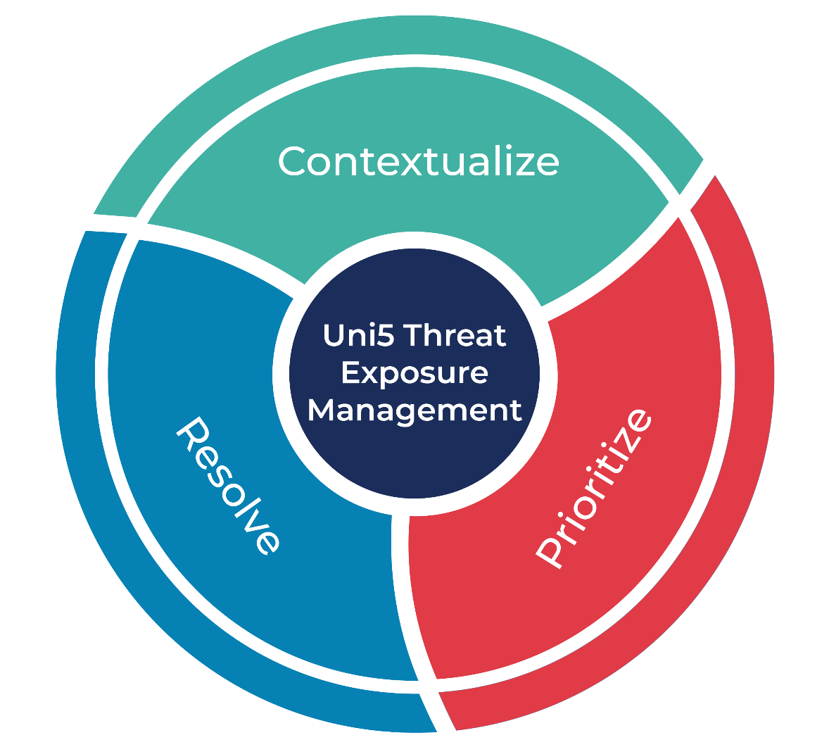

What Next?
At Hive Pro, it is our mission to detect the most likely threats to your organization and to help you prevent them from happening.
Book a free demo with HivePro Uni5:Threat Exposure Management Platform.
REPORT GENERATED ON
REPORT GENERATED ON
September 22, 2025 • 7:30 AM
© 2025 All Rights are Reserved by Hive Pro
More at www.hivepro.com
More at www.hivepro.com

